Slide 1
dentistry Latin 1st week
Orientation

Slide 2
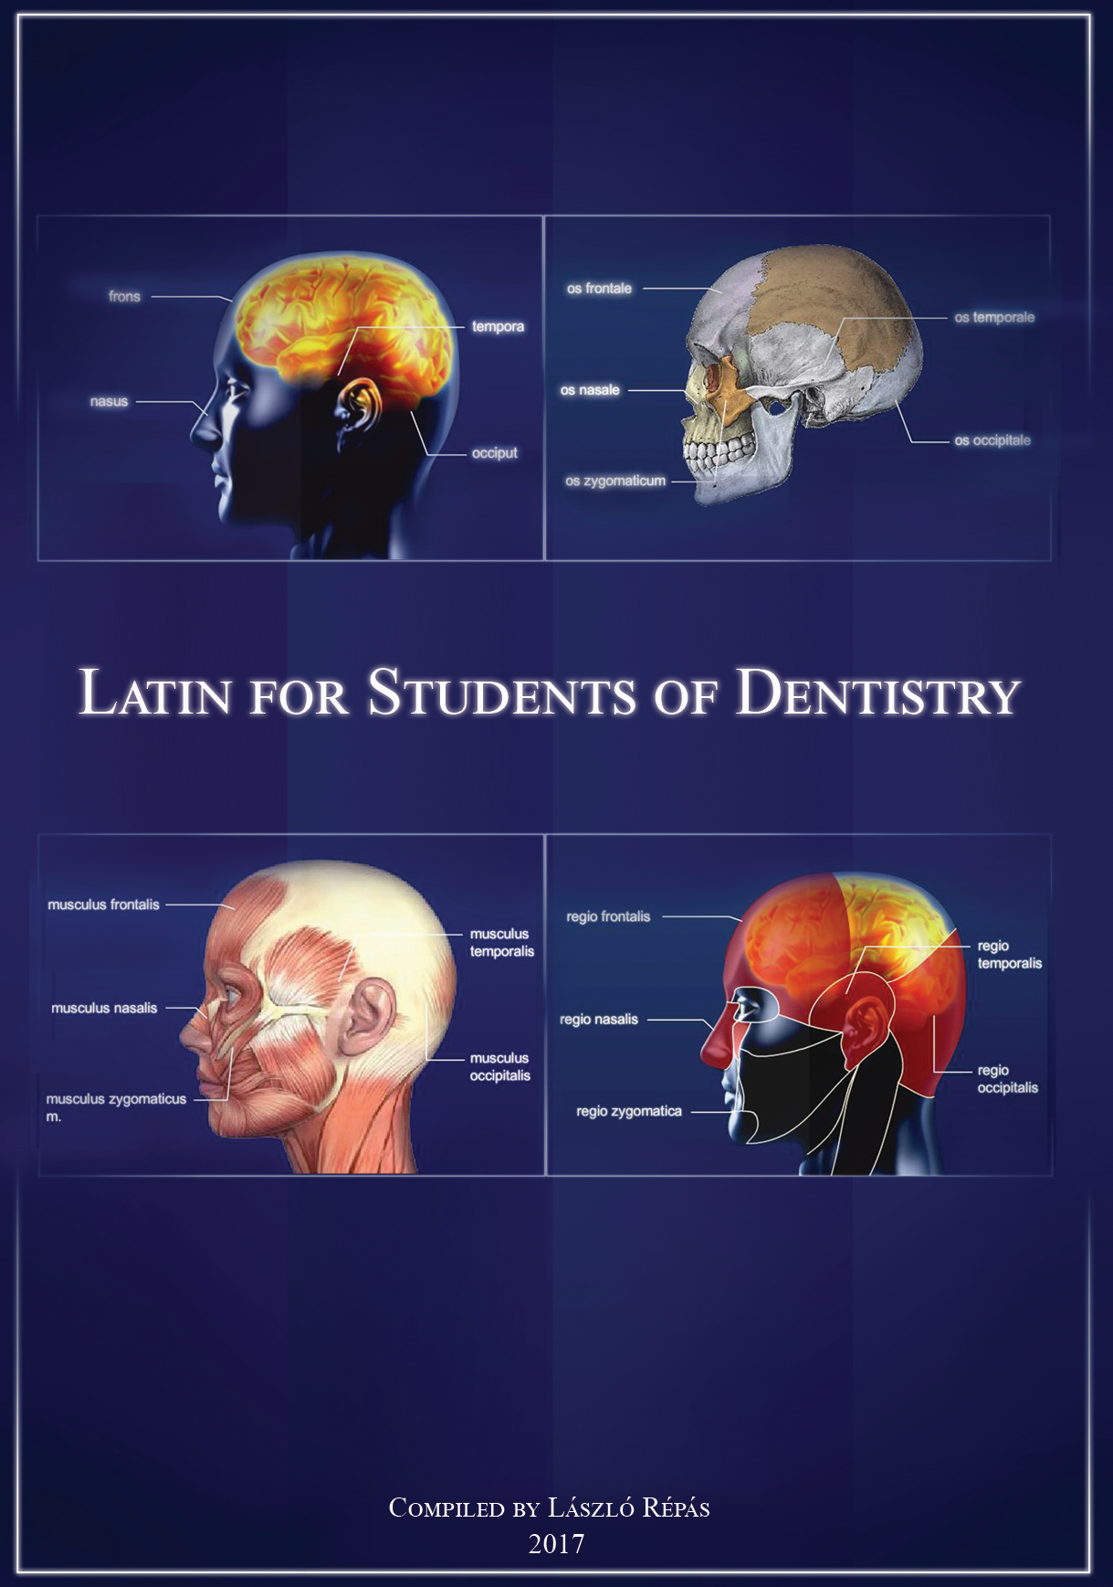
General information
Teachers: Mariann Gulyásné Szitás, László Répás
Email:
repasl@med.unideb.hu
mariann.szitas@gmail.com
Edu Center Room 312.
Neptun registration!!!
Website: ilekt.med.unideb.hu
User: Hallgato
Password: Hallgato
Coursebook:
Latin for Students of Dentistry
Order online at
www.medi-lingua.hu
http://medi-lingua.hu/products/latin-orvosi-szaknyelv/latin-for-students-of-dentistry
Pickup point at Xpress Copy LSB ground floor

Slide 3
Requirements
Attendance: maximum 2 absences
2 Tests
1st Test Week 7,
2nd Test Week 13
Word quizzes weekly(10)
10 --> min. 8 words correct → OK
Minimal: 3-3 passed vocab quizzes before Mid-Term and End-Term
1bonus point is added to Mid-Term and End-Term for each passed vocab quiz
Total final score: min. 60 % in average
60-69 % → 2 70-79 % → 3
80-89 % → 4 90-100 % → 5

Slide 4
Requirements
Students are required to bring the coursebook or other study material given out for the course with them to each language class.
Active participation is evaluated by the teacher in every class. If students’ behaviour or conduct does not meet the requirements of active participation or students fail to bring the coursebook to the class the attendance might be refused.

Slide 5
Requirements
If a student does not have 3-3 successful word quizzes till the mid-term and end-term tests he/she is not allowed to sit for the test.
If a student does not have minimum 6 successful word quizzes he/she has to take a vocabulary exam that includes all 300 words at the end of semester.
A failed or missed word quiz can be made up not later than one week and only with the student’s own teacher.
Students can obtain bonus points (5-5%) by taking the word quizzes successfully.

Slide 6
Requirements
Based on the final score the grades are given according to the following table:
Final score Grade
0 - 59 fail (1)
60-69 pass (2)
70-79 satisfactory (3)
80-89 good (4)
90-100 excellent (5)
If the final score is below 60, the student once can take a remedial exam covering the whole semester’s material.

Slide 7
Week | Topics covered
1 | Class introduction and Chapter 1 Introduction to medical terminology
2 | Chapter 2: Anatomical positions, planes and directions
3 | Chapter 3: Parts of the body; Vocab Quiz 1
4 | Grammar 1: Basic elements of Latin grammar; Vocab Quiz 2
5 | Chapter 4: The mouth and the teeth; Vocab Quiz 3
6 | Chapter 5; Regions; Formation of adjectives; Vocab Quiz 4
7 | Revision, Vocab Quiz 5 Mid-term Test
8 | Chapter 6: The skeletal system 1
9 | The skeletal system (2); Plural forms; Vocab Quiz 6
10 | Chapter 7: Joints; complex adjectives; Vocab Quiz 7
11 | Chapter 8: The muscular system; Vocab Quiz 8
12 | Chapter 9: Greek roots; Latin and Greek prefixes Vocab Quiz 9
13 | Revision 2; Vocab Quiz 10, End-term Test
14 | Evaluation

Slide 8
Latin in English context

Slide 9
In 1st century A.D.
In the year of the Lord; in the years of the Christian calendar era

Slide 10
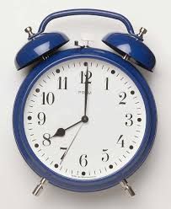
8 a.M./P.M.
a.m.= ”ante meridiem” = before noon, time from midnight to noon
p.m. = ”post meridiem” = after noon, time from noon to midnight

Slide 11
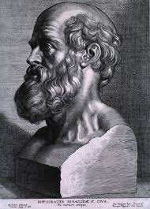
Hippocrates c. 460 – c. 370 BC
c.= circa
around 460 – approximately 370 BC

Slide 12
Please send a cv to the address below
CV = Curriculum Vitae
Document on your past employment and education, „course of life”

Slide 13
cf Rules and Regulations Section 32/2
cf = confer
Compare, used in references

Slide 14
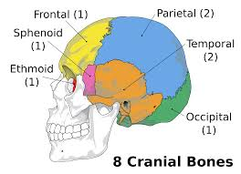
Cranial bones e.g. frontal and temporal bones
e.g. = exempli gratia
for example

Slide 15
”The Human Embryo” by Brodsky, Rosenblum, et al.
et al. =et alii
and others (co-authors, contributors)

Slide 16
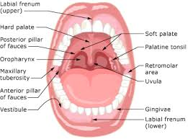
Teeth, gums, lips, tongue, etc. are part of the oral cavity
etc.= et cetera
and so on, „and others too”

Slide 17
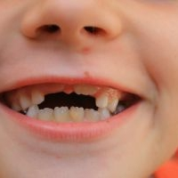
Humans are diphyodonts i.e. with two sets of teeth
i.e. = id est
= that is

Slide 18
NB
NB= Nota bene
= Note well, take special notice, it is important!

Slide 19
Best wishes, Julie. PS If Tuesday is not OK, let me know.
PS= Post scriptum
= Written after something

Slide 20
staff rejected a 1.8 per cent increase
per cent= per centum
= in or for every hundred, %

Slide 21
She is holding a PhD
PhD= Philosophiae Doctor
= Doctor of Philosophy

Slide 22
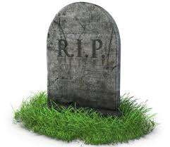
R.I.P. (on graves)
R.I.P.= Requiescat in pace
= Rest in peace

Slide 23
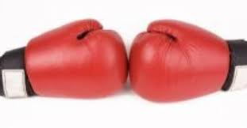
Tooth Decay Rates in Fluoridated vs. Non-Fluoridated Communities
vs. = versus
= against, as opposed to

Slide 24
citius, altius, fortius
Faster, higher, stronger

Slide 25
Mens sana in corpore sano (Carlton Football Club motto)
A sound mind in a healthy body

Slide 26
E pluribus unum
Out of more, one

Slide 27
I think therefore I am
(René Descartes)

Slide 28
Thank you for your attention ☺

